Slide 1

Cost Allocation Rules: Splitting Shared Costs
Introduction to cost allocation rules
Benefits of using cost allocation rules
Features of cost allocation rules
How to create a cost allocation rule
Using cost allocation rules in Azure Cost Management
Notes:
Slide 1 Cost allocation rules enable you to split costs across different resources, departments, or projects. This helps you to better understand the costs associated with each resource and optimize your cloud spending. In this presentation, we will explore the benefits and features of using cost allocation rules and how to create and use them in Azure Cost Management.

Slide 2

How to Create a Cost Allocation Rule
Configuring the cost allocation rule- source and targets resources.
Selecting the cost allocation method- proportional to the cost (total, compute, storage, network), distribute evenly or custom ratio.
Visualize the cost allocation rule on cost analysis or the usage+purchase file
Notes:
Slide 5 To create a cost allocation rule, you need to select the cost allocation method, configure the rule, and test it. You can use Azure Cost Management to create and manage your cost allocation rules.

Slide 3
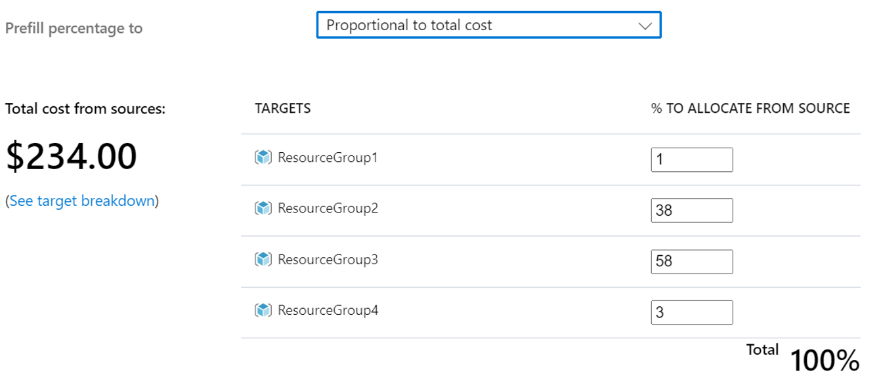
Features of Cost Allocation Rules
Define multiple source and target resources.
Splitting costs by tags.
Splitting costs by resource groups.
Splitting costs by subscriptions.
Splitting happens in the ratio of total cost, cost by compute, network, storage, distribute evenly, or custom.
Notes:
Slide 4 Cost allocation rules can split costs across different resources, departments, or projects using tags, resource groups, or subscriptions. This enables you to allocate costs to the right resources and gain a better understanding of your cloud spending.

Slide 4
Benefits of Using Cost Allocation Rules
Better visibility into cloud spending
Splitting of the shared cost
100% cost allocation by cost centers
Notes:
Slide 3 Using cost allocation rules can help you to better understand your cloud spending, improve your cost optimization efforts, and provide more accurate cost reporting. This enables you to make informed decisions and optimize your cloud spending.

Slide 5
Things to consider
Cost Allocation rule currently supports only EA or MCA customers.
The precedence of rules processing happens by the time of rule creation.
When a cost allocation rule applies to a source and target resource, it create a negative entry in the cost for the source, while a positive entry in the cost for the target resource.
Notes:
Slide 6 Azure Cost Management provides a user-friendly interface for creating, viewing, and managing your cost allocation rules. You can use it to gain insights into your cloud spending and optimize your costs.

